Slide 1


UNIVERSITY OF RAJASTHAN
SRI BALAJI P.G. MAHAVIDYALAYA
BCA 2022 - 2025
Head of Department : Inder Verma
Under the Supervision of : Dr. Divya Sain
Submitted by : Animesh Mathur

Slide 2
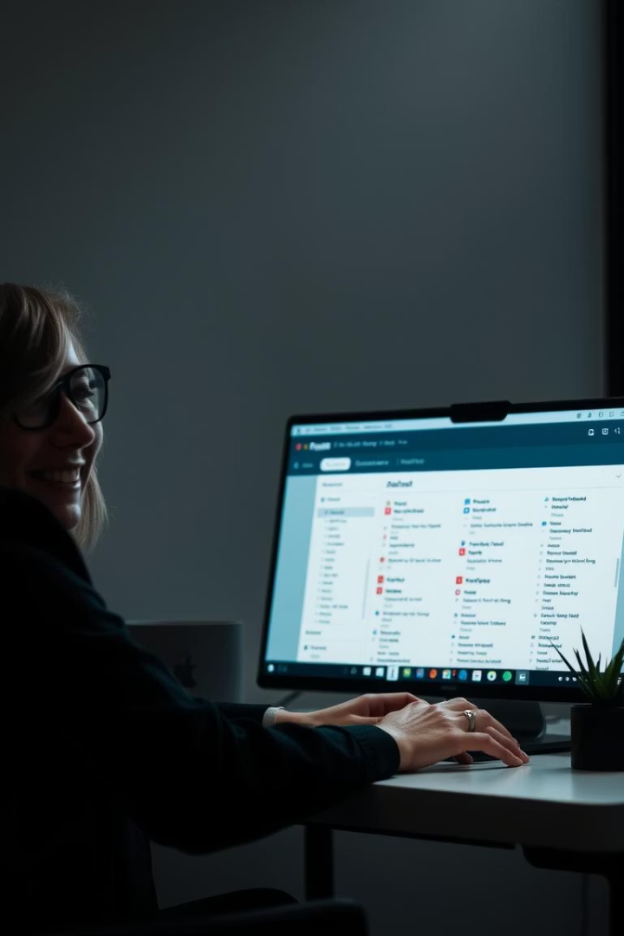
Talking Dictionary: Your Ultimate Language Companion
Talking Dictionary provides instant word meanings and pronunciations. It is more than just a dictionary; it is a powerful language learning tool. It is available for Windows, macOS, and Linux.
by Animesh Mathur
AM

Slide 3
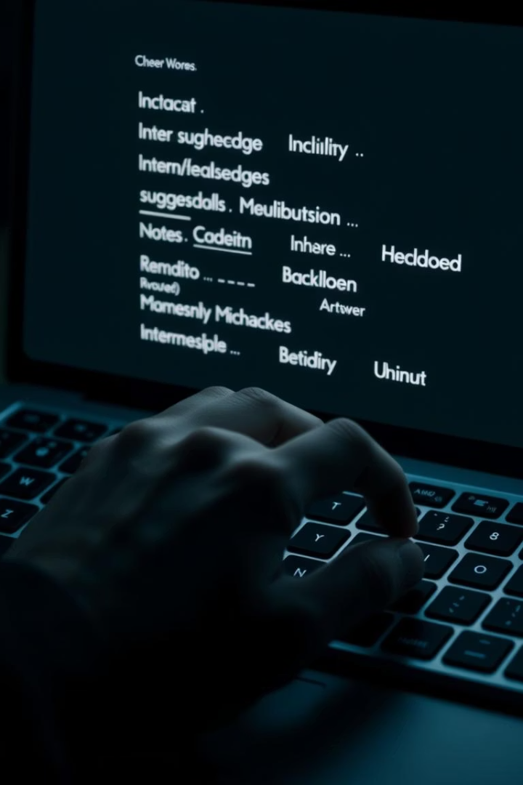
Technology and Enviroment
Pycharm (pycharm-community-2024.3.5.exe)
Python (tkinter,pyttsx3,difflib, random)
Json (Directory File)

Slide 4



Smart Suggestions: Spelling Correction
Intelligent Algorithm
Saves Time
Learns from History
Reduces frustration and saves time.
Suggests correct spellings as you type.
Learns from your search history to improve suggestions.

Slide 5
Core Functionality: Search and Definition
Instant Definitions
Comprehensive Database
Offline Access
Type a word and get instant definitions and example sentences.
It is powered by a comprehensive database of 500,000+ words.
Offline access to definitions are available for uninterrupted learning.

Slide 6
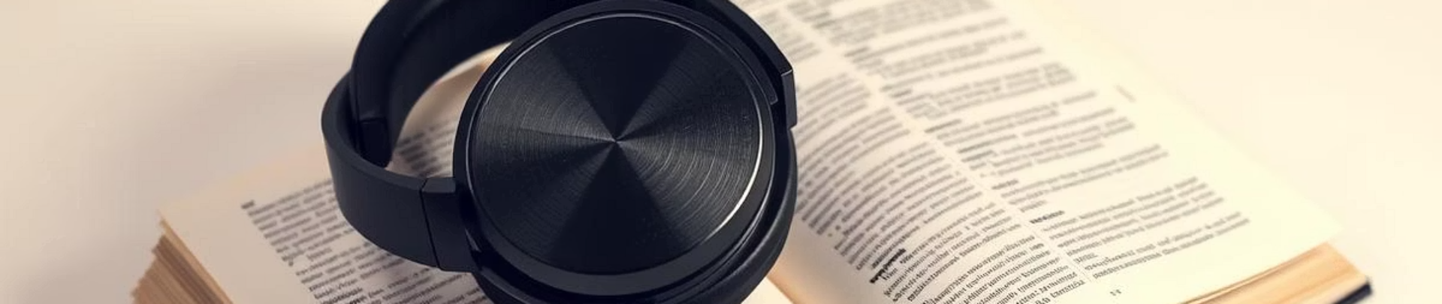


Hear It Right: Pronunciation Feature
Clear Pronunciations
Voice Options
Enjoy clear, natural-sounding audio pronunciations.
Choose between male and female voice options.

Slide 7
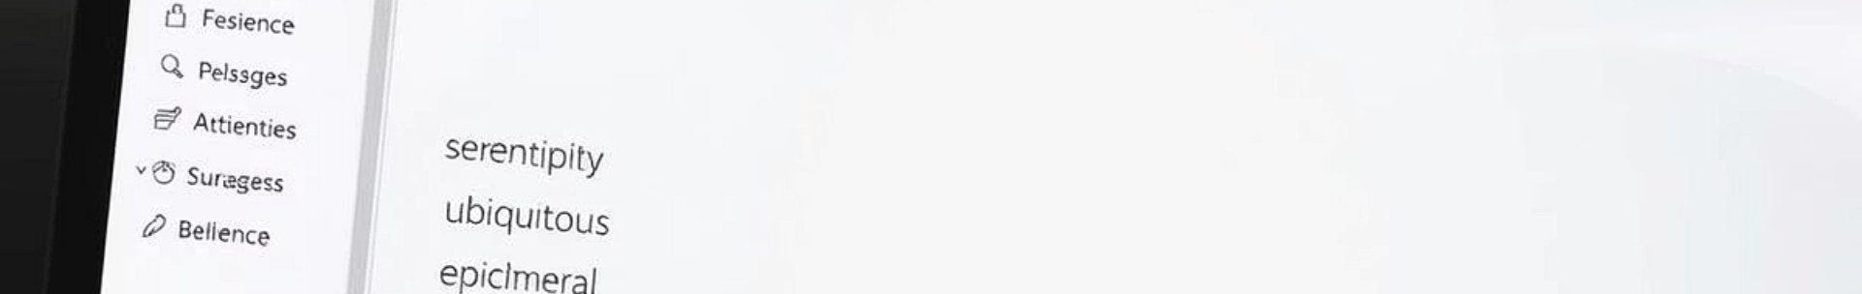
History: Review Your Recent Searches
Automatic Storage
1
Automatically stores your recent word searches.
2
Revisit Definitions
Easily revisit past definitions.
Clear History
3
Clear history with a single click.

Slide 8
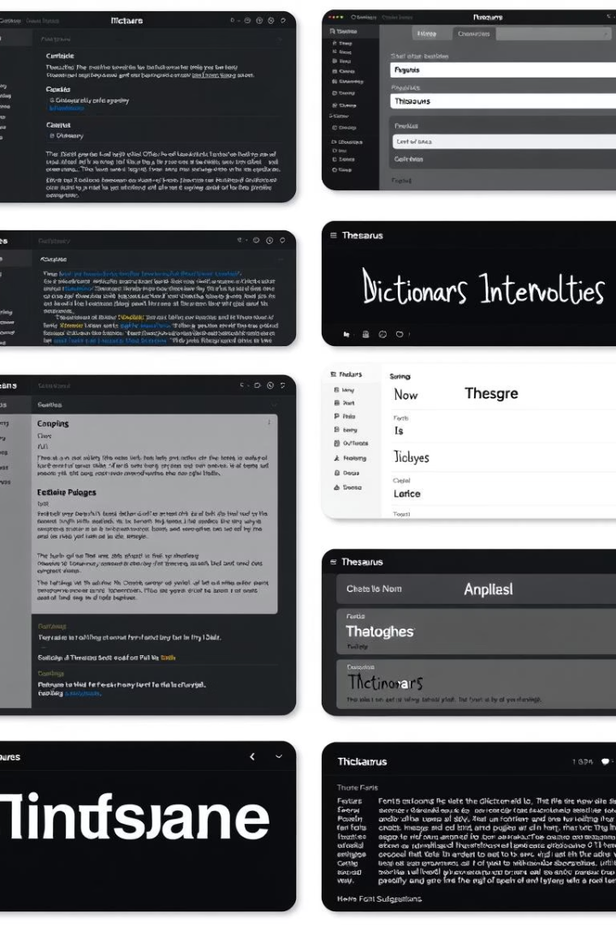
Additional Features for Enhanced Learning
Dark Mode
Word of the Day
For comfortable nighttime use.
Enhance your vocabulary
Add Favourite
Add any word as favourite word

Slide 9
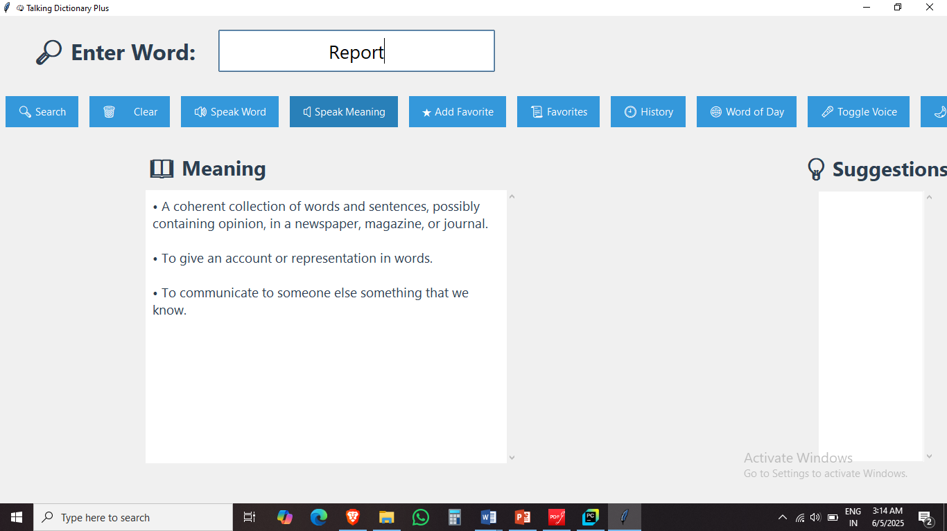
GUI

Slide 10
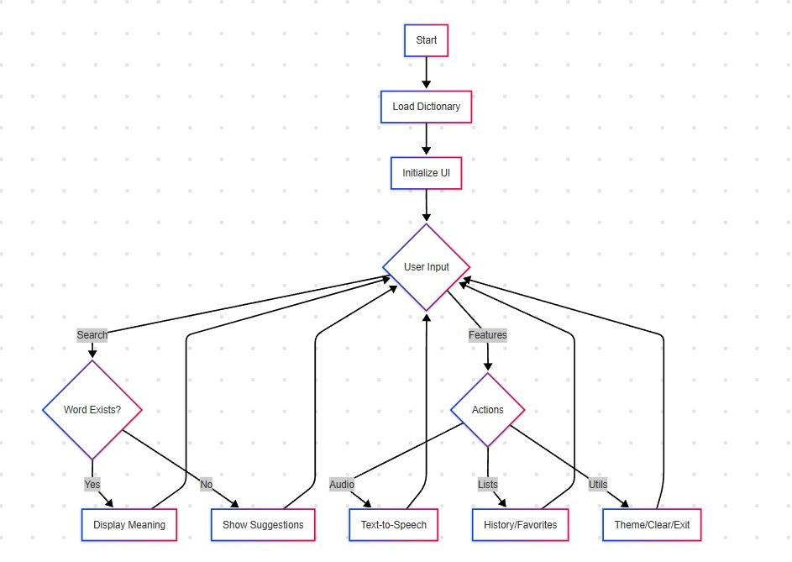
Flow Chart

Slide 11
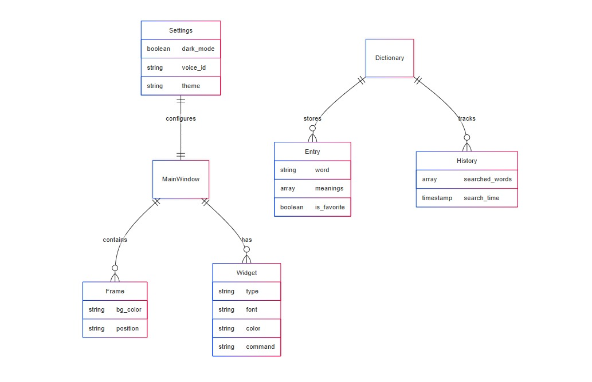
ER Diagram

Slide 12
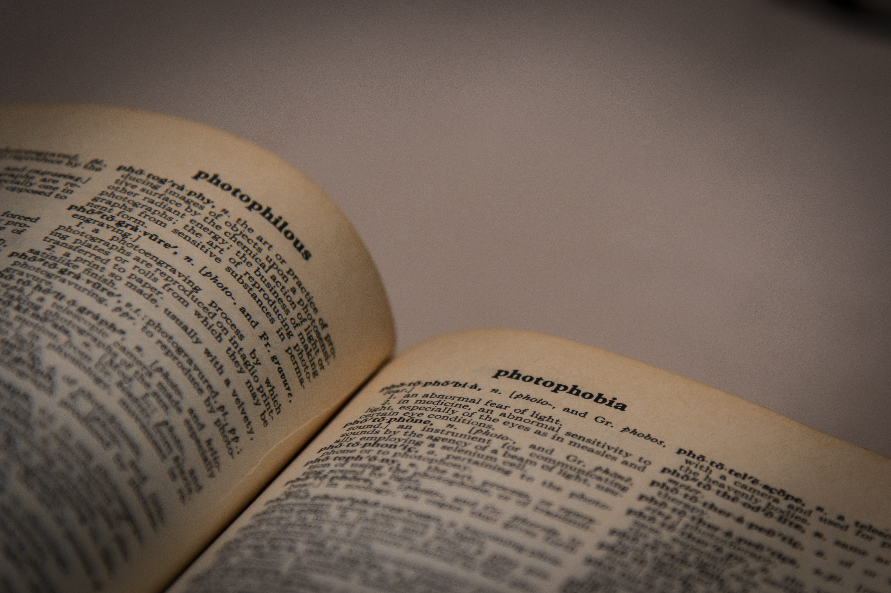
Conclusion
In conclusion, the Talking Dictionary project demonstrates how technology can enhance language learning by making it more interactive and accessible. With features like audio pronunciation, a clean GUI, and user-friendly navigation, it serves as an effective educational tool. This project highlights the power of Python and Tkinter in building practical desktop applications. With future improvements like multilingual support or voice input, the possibilities are even greater. Thank you for your time and interest!

Slide 13
THANK YOU

